Slide 1


CLOSER 2024
On Detecting Malicious Code Injection by Monitoring Multi-level Container Activities
Md. Olid Hasan Bhuiyan¹, Souvik Das¹, Shafayat Hossain Majumder²,
Suryadipta Majumdar², and Md. Shohrab Hossain²
¹Bangladesh University of Engineering and Technology, Bangladesh
²Concordia University, Canada
Notes:
Hello Everyone,
My name is Md. Olid Hasan Bhuiyan and I'm thrilled to be here today to share with you some insights from my research paper titled "On Detecting Malicious Code Injection by Monitoring Multi-level Container Activities." This is a joint work between “Bangladesh University of Engineering and Technology” and “Concordia University, Canada”.

Slide 2
Outline
Motivation
Related Works
Problem Statement
Methodology
Performance Evaluation
Concluding Remarks
Notes:
In the next few minutes, I will take you through exploring the existing works of container security and unveiling our innovative approach to enhance malicious code injection detection. Here we have listed the topics that we’ll touch upon today. Let’s start with understanding the motivation behind our work.

Slide 3

Motivation: Container Issues
Security measure (Door lock)
A temporary office built with several containers
Notes:
Let's say you're hosting a large outdoor event, and you've set up a number of shipping containers to serve as temporary offices, storage spaces, and restrooms.

Slide 4

Motivation: Container Issues
How can I break in??
Notes:
One day, a group of thieves breaks into the event grounds and gains access to the shipping containers. They realize that one of the containers contains valuable equipment, but it's locked with a sturdy padlock.

Slide 5


Motivation: Container Issues
Found the weak point of a container!
Notes:
Instead of trying to break the lock, the thieves use a cutting torch to cut a hole in the side of the container. Once inside, they quickly grab the equipment and make their escape. The hole in the container is small enough that it's not immediately noticeable, and the theft goes undiscovered until the event is over.
In this scenario, the shipping container is analogous to a container in a software environment, and the padlock represents security measures such as access controls and authentication. The thieves' use of a cutting torch to bypass the lock is similar to an attacker exploiting a vulnerability or weakness in a container's security measures to gain unauthorized access to the underlying system or data. The theft itself is equivalent to data theft or a breach of sensitive information in a software environment.

Slide 6
Motivation: Summary
Increasing usage of container technology and its weak security system
Malicious code injection is the initiator to many other attacks
Malicious code injection is difficult to detect and fix due to the complexity in container layering
Notes:
Now a days, container is highly used despite its weak security system
We target malicious code injection attack because this attack can result in many more severe attacks and it is quite hard to detect a malicious code injection attack. This is because it can be done in many ways, following different paths. We are going to talk about the paths that finally lead to malicious code injection in the later section of our presentation.

Slide 7



Advantages
Disadvantages
Portable
Highly scalable
Isolated
Individual security mechanism
Multi-tenant service
Large attack surface
Communication complexity
Thin protection layer

Slide 8

What is a container?

Slide 9


What is a container?
“A lightweight OS-level virtualization method”
“Stand-alone piece of executable software”
“NOT a virtual machine”
“Process with isolation, shared resources and layered filesystem”

Slide 10
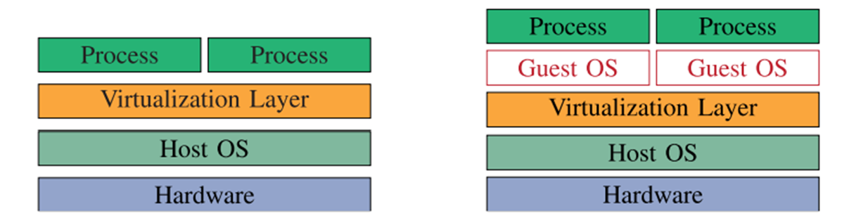
Container vs VM
Shared OS
Less secured
More suitable for microservice
Separate OS for each process
More secured
Less suitable for microservice
Container
VM

Slide 11
Related Works
Limitations
Proposed a common solution - mostly using sequence of system calls
Abed et al. [1]
Suggested a host-based intrusion detection mechanism
Used BoSC (Bag of System Call) technique
Tool used: strace
Cavalcanti et al. [3]
Proposed a container-level anomaly-based intrusion detection systems for multi-tenant applications
Mainly worked on four different vulnerabilities - Authentication Bypass, DoS Overflow, System User Privilege Escalation and Integer Overflow
Tool used: sysdig
Did not cover all potential attack paths of malicious code injection
Notes:
Now, let's take a look at what previous research has contributed to this field. We'll discuss existing works, examining their strengths and limitations. By building upon the foundation laid by previous works, we aim to introduce innovative approaches that address gaps in current detection methods.
The first work mentioned here suggested a host-based intrusion detection mechanism. They used BoSC technique (Bag of system call technique for their work) and they used Strace tool for that.
The second work Proposed a container-level anomaly-based intrusion detection systems for multi-tenant applications. Mainly worked on four different vulnerabilities - Authentication Bypass, DoS Overflow, System User Privilege Escalation and Integer Overflow. Tool used: sysdig

Slide 12
Related Works
Souppaya et al. [4]
Discussed the possible security issues raised by the usage of containers and offers suggestions for resolving them
Limitations
Did not implement their suggested methodology and evaluated it using any kind of performance metrics, let alone work on a specific attack signature
Yarygina et al. [9]
Proposed a flexible, cost-conscious intrusion response system for microservices that employs a game-theoretic method to automatically respond in real time to network threats
Sarkale et al. [10]
Suggested a new security layer using the Most Privileged Container (MPC)
MPC layer implements privilege-based access control and grants permissions for resource access based on rules
Notes:
The next one Discussed the possible security issues raised by the usage of containers and offers suggestions for resolving them. But they did not implement their proposal. Same goes for the next one as well.
The last work mentioned here Suggested a new security layer using the Most Privileged Container (MPC). This MPC layer implements privilege-based access control and grants permissions for resource access based on rules. They did not implement their proposal either.

Slide 13
Related Works: Gap Analysis
Using a general solution or detection mechanism for different types of attacks
Absence of attack specific detection mechanism
Some of the research works only proposed a methodology, did not even test their suggested method
None of these research works are related to multi-level protection in containerized environment
Notes:
So, as we can see previous works in this field has some limitations. Most of them used a general solution or detection mechanism for different types of attacks. They did not work on attack specific detection mechanism. Some of the research works only proposed a methodology, did not even test their suggested method. And most importantly, None of these research works are related to multi-level protection in containerized environment.

Slide 14

Problem Statement
Malicious code injection
A type of cyber attack where an attacker inserts malicious code into a vulnerable application or system, with the intent of compromising the security or functionality of the target.
There are several potential attack paths to insert malicious code into a container.
Notes:
Next, let's define the problem we're addressing. We'll outline the specific challenges and objectives of our research. What is a malicious code injection attack - A type of cyber attack where an attacker inserts malicious code into a vulnerable application or system, with the intent of compromising the security or functionality of the target. There are several potential attack paths to insert malicious code into a container.

Slide 15
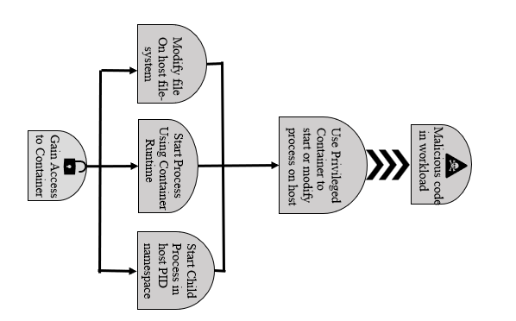
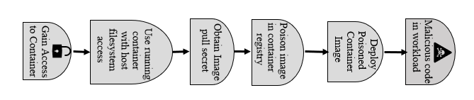
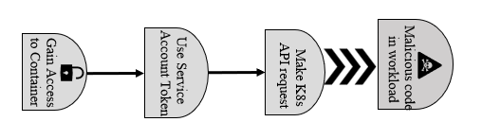
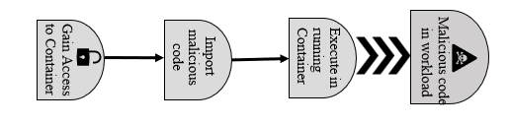
Problem Statement
Examples: XSS attack
SQLi attack
RBAC attack
CSRF attack
Notes:
For example, we can implement malicious code injection using leveraging XSS, CSRF, SQLi and RBAC attack. We have got these attack paths from CNCF.
The aim of this attack tree is to execute malicious code on a cluster. The initial foothold for these threats are primarily through a compromised application providing access to the container, this is perhaps the most likely initial foothold into the Kubernetes environment and one to carefully mitigate. Note that the vulnerable container may be accessed from either a NodePort on a node or more likely the external network directly.
Once an attacker gains access to a container the next step in this attack tree is to move towards loading additional malicious code into the environment. There are multiple attack vectors here depending upon the privilege level of the container
For XSS attack, an attacker first need to gain access to the vulnerable container. Then he has to import the intended code and finally execute it.
For SQLi attack, an attacker has to have basic idea about the database structure.
In case of RBAC attack, a service token is needed that belongs to default namespace. With that token, the attacker with make an API request that import malicious code in the vulnerable container.
Finally, in case of CSRF attack, the attacker has to create a trustworthy website and deploy its image in a container. The attackers lure the victim to perform an action in that poisoned website. if the Image pull secret can be obtained there is a potential that the attacker could poison the repository to distribute the malicious code from there.

Slide 16


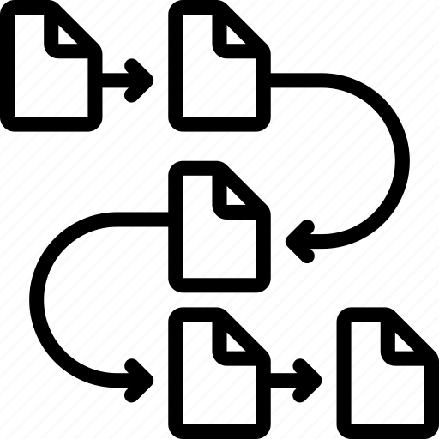


Problem Statement: Our Goal
Our aim: Detecting malicious code injection in container for all potential attack paths
Achieved by:
1. Monitoring different levels of container
2. Fetching different features(name, sequence, frequency) of system calls
3. Using different tools like sysdig, strace and kubernetes dashboard
Notes:
So our aim is to detect malicious code injection in container for all potential attack paths.
We can achieve this by
1. Monitoring different levels of container
2. Fetching different features(name, sequence, frequency) of system calls
3. Using different tools like sysdig, strace and kubernetes dashboard

Slide 17
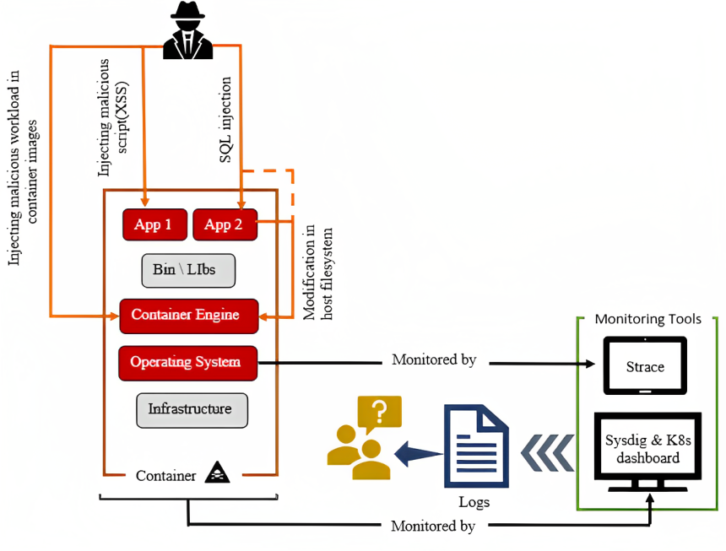
Proposed Approach: Summarized View
Reverse engineering tool
Our proposed container monitoring system
Notes:
This image summarize the main working principle of our proposed mechanism. As we can see, XSS and SQLi attack happens in application layer and container engine and operating system layer get affected as a of the attacks. So, we are going to monitor several layers our container. The operating system layer is going to be monitored by Strace and the whole container is monitored by strace and Kubernetes dashboard. These are all reverse engineering tools.

Slide 18
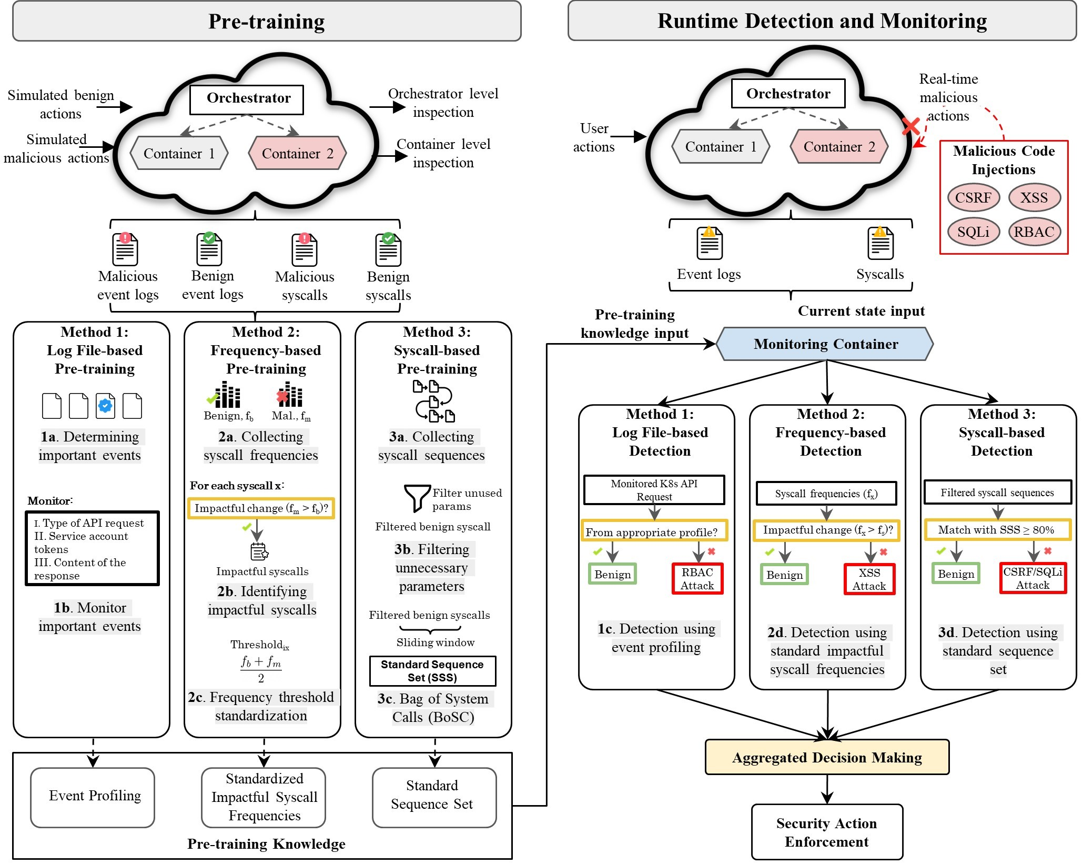
Proposed Approach: Detailed View
Notes:
Moving on to our methodology, we'll provide an overview of the principles and techniques used to detect malicious code injection.
This is our approach overview. There are two major stages here –
Pretraining phase
Runtime detection and monitoring phase
There are some section under each of these stages. We are going to discuss each of these section in more details.

Slide 19
Methodology: Steps
Simulate normal user activity on the container based applications
Simulate attack following the attack paths to inject malicious code
Collect container activities through syscall parameters and event logs
Malicious code injection detection using the benign behaviour model
Designing syscall parameter blueprint to detect malicious code injection
Syscall Filtering
Notes:
In the first step of our methodology, we are going to simulate both benign and malicious activity in a container. We are going to then collect these activities using different system call parameters like frequency, sequence and event logs. Now to reduce the overload and to make our detection system efficient, we will do some filtering to filter out unnecessary system calls and parameters. After that using the existing data, we are going to design a blueprint to detect malicious activities. Finally, we are going to evaluate our system against malicious and benign activities in containers.

Slide 20
Methodology: Step 1
Simulate normal user activity on the container based applications
Have simulated 4 different container based applications(based on seed-ubuntu)
To implement 4 different attacks(XSS, CSRF, SQLi and RBAC attack)
To generate data for benign activities
2. Tools and platform we used for our simulation are:
Operating system: Seed Ubuntu 20.04
Local kubernetes orchestrator: Minikube v1.28.0
Reverse engineering tools: Strace, Sysdig, Minikube dashboard
Notes:
To simulate normal user activity in container based application, we use 4 different applications. Our operating system is Seed Ubuntu. As local Kubernetes orchestrator, we use minikube and several reverse engineering tools like strace, sysdig and minikube dashboard are also used.

Slide 21
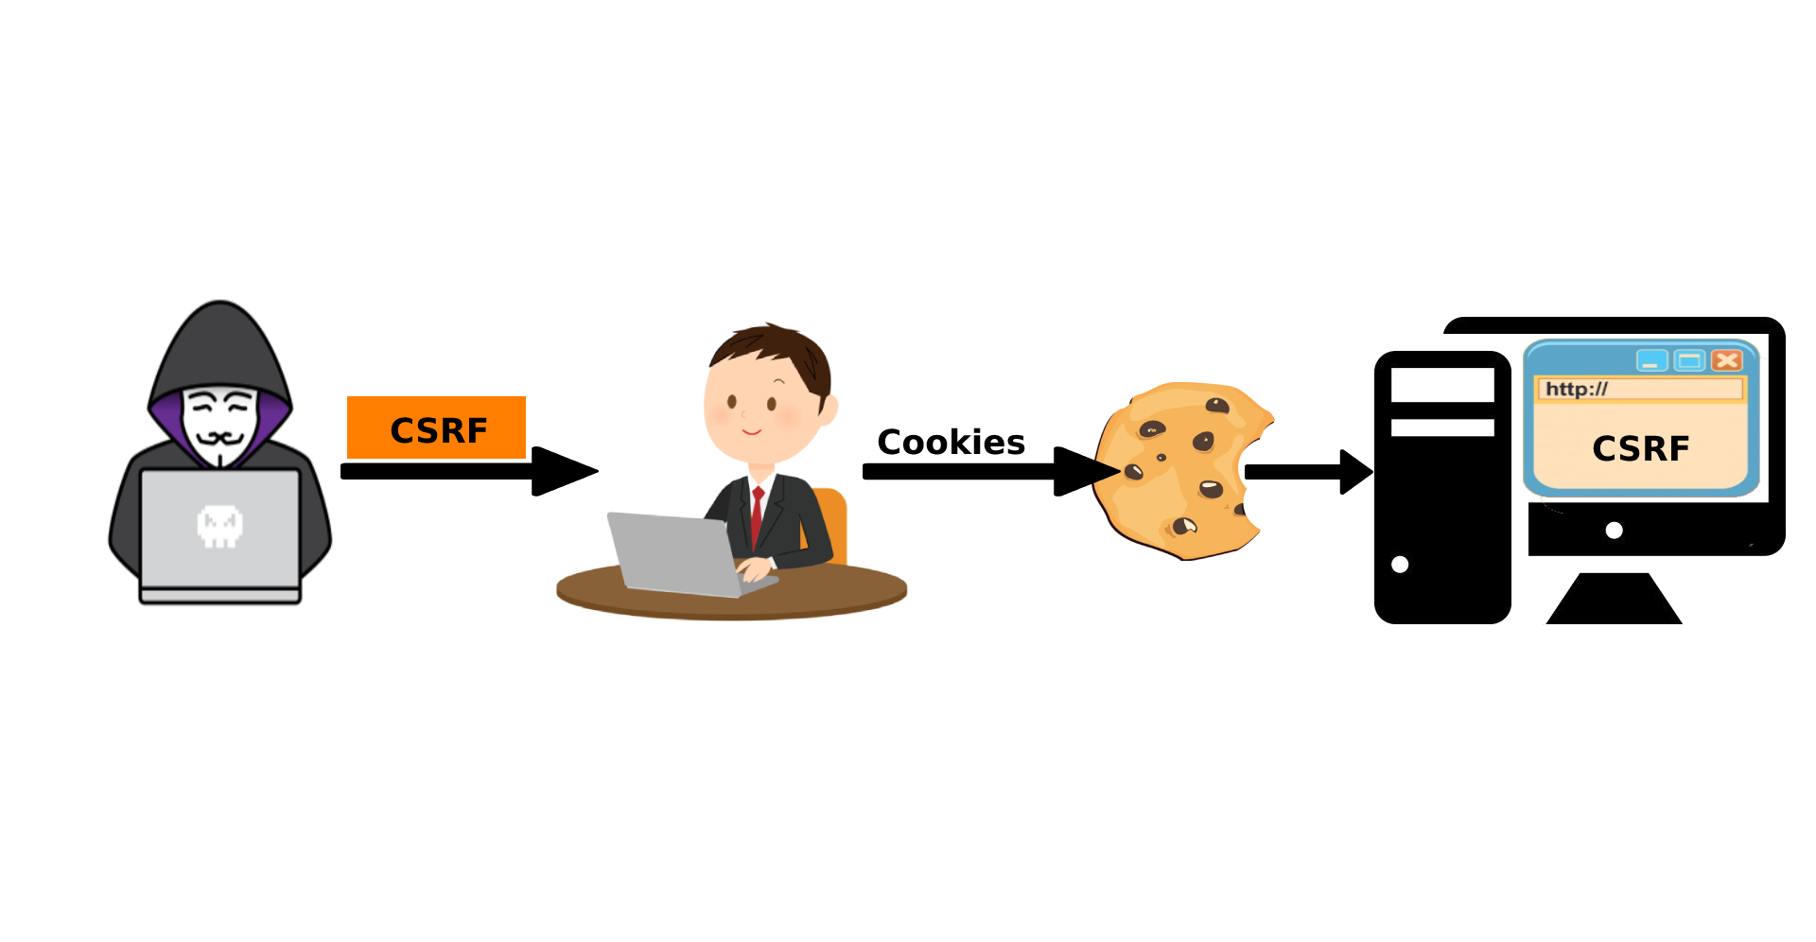

Methodology: Step 2
Simulate attack following the attack paths to inject malicious code
CSRF attack
XSS attack
Notes:
Next we simulate 4 different attacks following the attack paths from CNCF.
In CSRF (Cross-Site Request Forgery) attack, an attacker tricks a user into unintentionally executing actions on a website they're authenticated on. The attacker crafts a malicious request and tricks the user into triggering it, usually by enticing them to click a link or visit a page controlled by the attacker. Because the request is sent from the user's browser with their authentication credentials, the website believes it's a legitimate request and executes the action, potentially leading to unauthorized operations
In XSS (Cross-Site Scripting) attack, attackers inject malicious scripts into web pages viewed by other users. These scripts can be JavaScript or other code that can execute in the context of the user's browser. When unsuspecting users visit the compromised page, their browsers execute the injected script, allowing the attacker to steal sensitive information, session tokens, or manipulate the page content.

Slide 22
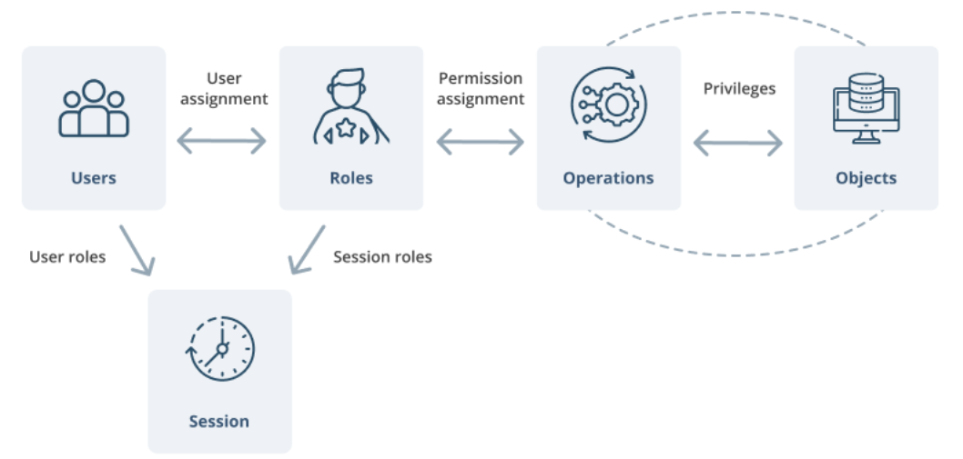
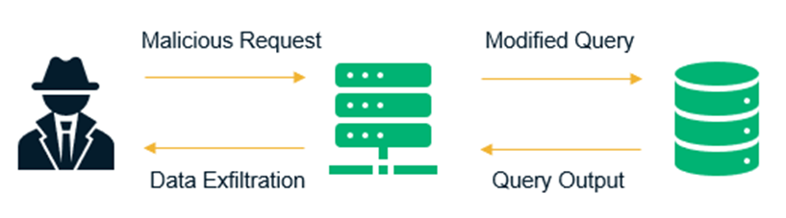
Methodology: Step 2 (Contd.)
Simulate attack following the attack paths to inject malicious code
SQLi attack
RBAC attack
Notes:
In case of SQLi (SQL Injection) attack, malicious SQL code is inserted into input fields of a web application, exploiting vulnerabilities in the application's database layer. When this manipulated input is processed by the application, it can modify SQL queries to execute unintended commands, such as retrieving, modifying, or deleting data from the database.
In RBAC attack, in our case, the attacker creates a container that has a default service account token. But that container has a script inserted in it that allows it to make an API request to the containers in master node to retrieve valuable information.

Slide 23
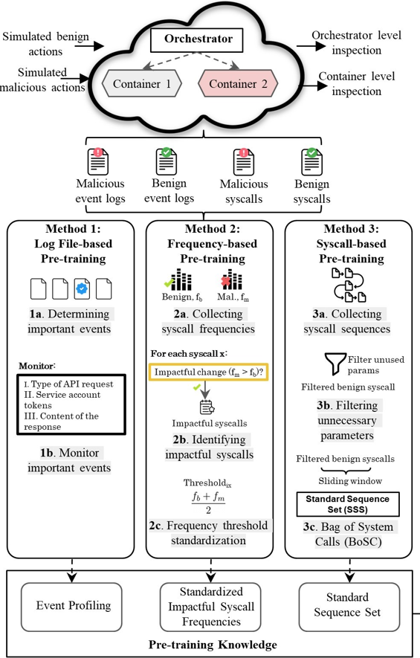
Methodology: Step 3
Collect container activities through syscall parameters and event logs
Collect container activities expressed through different features of system calls like frequency, name and sequence
Gather event log files using minikube dashboard to track user activity
Notes:
Next step in our methodology is to Collect container activities through syscall parameters and event. We use minikube dashboard to collect event logs, Strace to collect system call sequence and Sysdig to collect system call frequency.

Slide 24
Methodology: Step 4
Syscall Filtering (Sequence)
Notes:
Then we do system call filtering. We do that for both frequency and sequence. In case of sequence, we drop unnecessary parameters like timestamp.

Slide 25
Methodology: Step 4 (Contd.)
Syscall Filtering (Frequency)
Notes:
One of our major contributions is in filtering system call frequency. While working with frequency, we noticed that some system call does not change their frequency irrespective of what action we do in our container application. So, based on the frequency change, we find out some impactful system calls. This filtering is quite helpful to improve the efficiency and reduce the workload of our mechanism.

Slide 26
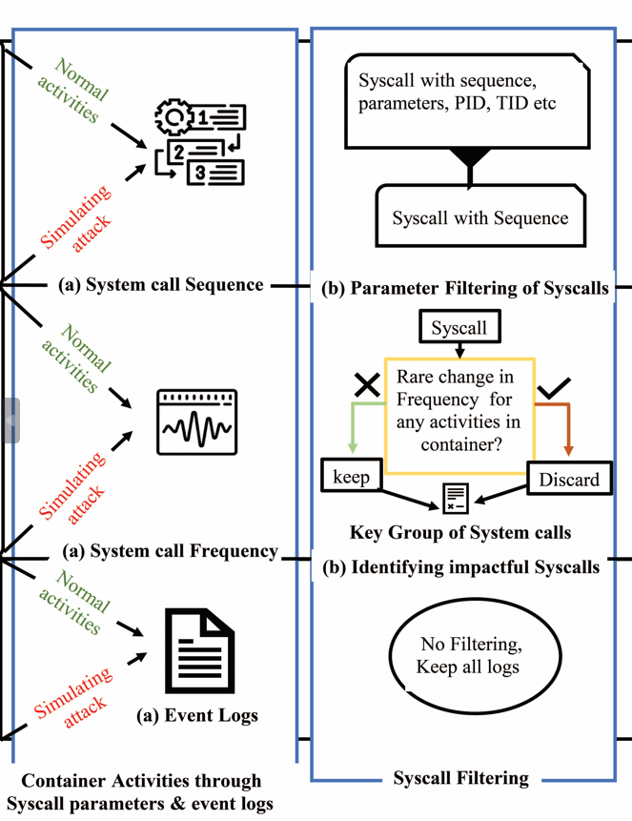
Methodology
Syscall Filtering

Slide 27
Methodology: Step 5
Designing syscall parameter blueprint to detect malicious code injection
Notes:
Our next step is to Design syscall parameter blueprint to detect malicious code injection. For event logs, we mainly focused on three aspects –
Type of API request
The service account token that makes the API request and
Content of the response.
In case of frequency, we set up a standard frequency for each of the system calls for benign activities. As a result, we build a threshold range for each impactful system calls. Finally, we use BoSC (Bag of system call) technique to build a standard sequence set for each action in our container application.

Slide 28
Methodology: Step 5 (Contd.)
Designing syscall parameter blueprint to detect malicious code injection
BoSC technique
S₁-S₂-S₃-S₄-S₅-S₆-S₇-S₈-S₉-S₁₀-S₁₁ … S_{n}
Notes:
Now let’s take a look at Bag of system call technique. Suppose this is sequence of system calls. Here S1, S2… represent system calls. We get this sequence while doing benign activities in our application. For the simplicity of understanding, we take a Bag size of 3, in our case, S1-S2-S3.

Slide 29

Methodology: Step 5 (Contd.)
Designing syscall parameter blueprint to detect malicious code injection
BoSC technique
If this sequence does not exist in benign sequence dataset, insert this sequence to this dataset
S₁-S₂-S₃-S₄-S₅-S₆-S₇-S₈-S₉-S₁₀-S₁₁ … S_{n}
S₁-S₂-S₃
Notes:
Now if this sequence does not exist in benign sequence dataset, we insert this sequence to this dataset.

Slide 30
Methodology: Step 5 (Contd.)
Designing syscall parameter blueprint to detect malicious code injection
BoSC technique
If this sequence does not exist in benign sequence dataset, insert this sequence to this dataset
S₁-S₂-S₃-S₄-S₅-S₆-S₇-S₈-S₉-S₁₀-S₁₁ … S_{n}
S₁-S₂-S₃
If this sequence already exists in benign sequence dataset, increase this sequence count by 1
Notes:
otherwise increment its occurrence by 1.

Slide 31
Methodology: Step 5 (Contd.)
Designing syscall parameter blueprint to detect malicious code injection
BoSC technique
If this sequence does not exist in benign sequence dataset, insert this sequence to this dataset
S₁-S₂-S₃-S₄-S₅-S₆-S₇-S₈-S₉-S₁₀-S₁₁ … S_{n}
S₂-S₃-S₄
If this sequence already exists in benign sequence dataset, increase this sequence count by 1
Notes:
Then we slide by one system call and thus get another sequence (S2-S3-S4). We do same thing for this sequence as well. This is how, we build a standard sequence dataset for our application.

Slide 32
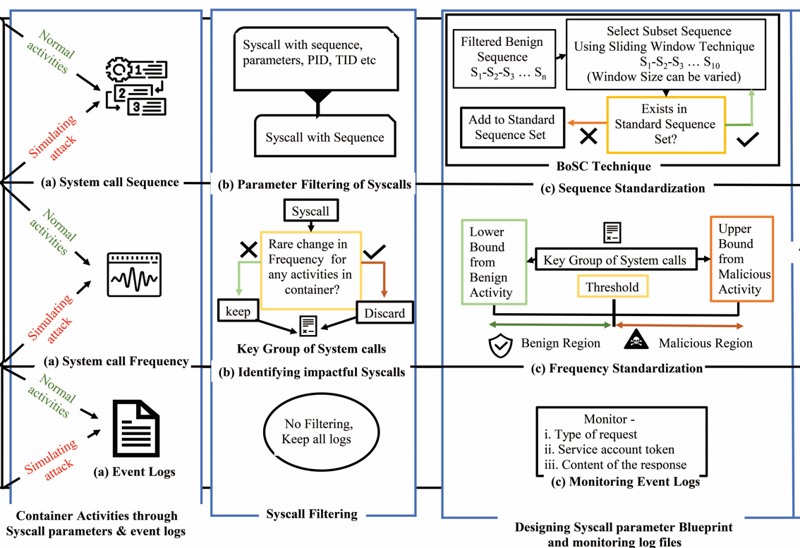
Methodology: Step 5 (Contd.)
Designing syscall parameter blueprint to detect malicious code injection

Slide 33
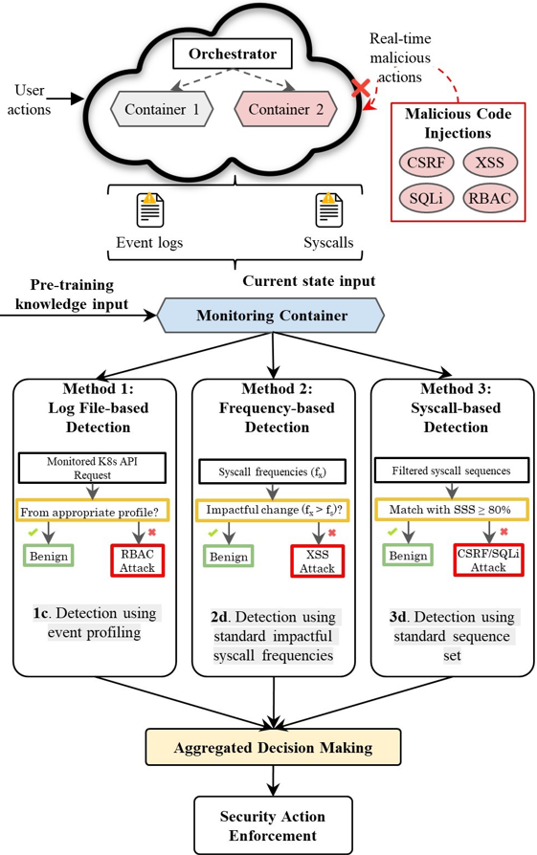
Methodology: Step 6
Malicious code injection detection using the benign behaviour model
Notes:
Last step of our methodology is to Malicious code injection detection using the benign behavior model. For event logs, if we notice that the API request and the content of the response are for privileged account but the service account token is from default account, we consider this request as a malicious action. In case of frequency, if a certain percentage of system calls crossed the limit of their standard threshold, we call this a malicious action in our system. Finally for sequence, if a sequence has 80% or more match with our standard sequence set, we call this a benign action otherwise malicious.

Slide 34
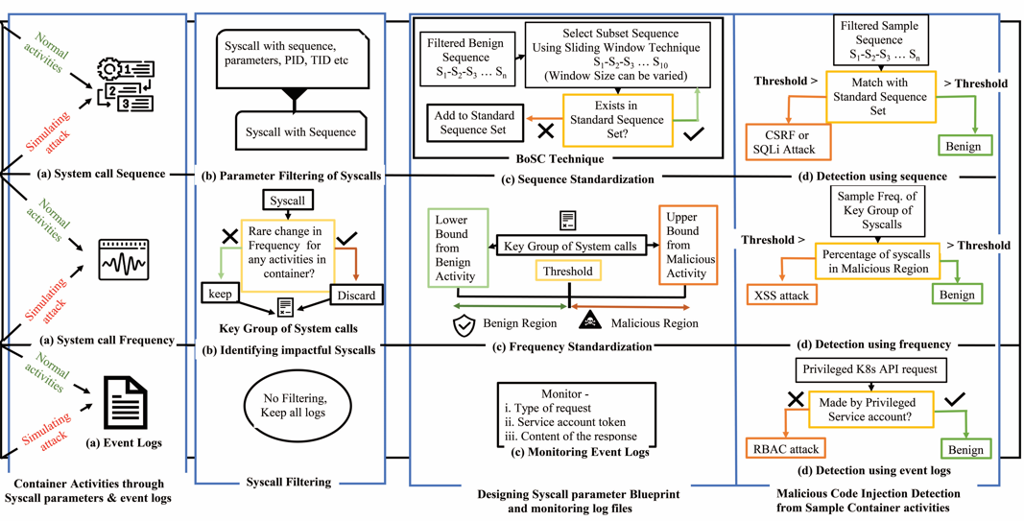
Methodology: Step 6 (Contd.)
Malicious code injection detection using the benign behaviour model

Slide 35
Methodology: Classification of Our Detection Mechanism
We can classify our detection mechanism in two main classes:
K8s log file based detection
System call based detection
System call based detection can be divided into two more classes:
Sequence based detection
Frequency based detection
Notes:
So based on our methodology, we can say our detection mechanism can be classified into two categories.
Log file based Detection
System call based Detection
Frequency based
Sequence based

Slide 36
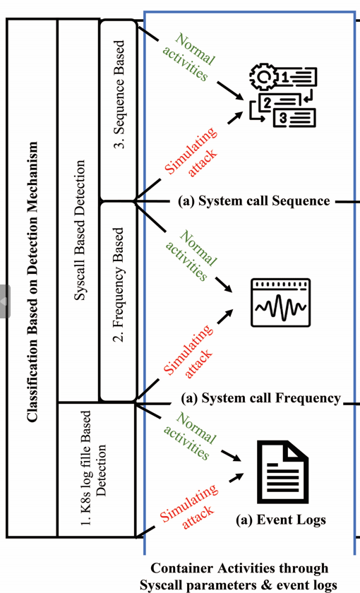
Methodology
Classification of our detection mechanism

Slide 37
Performance Evaluation
We are able to achieve decent score compared to the solution provided by Cavalcanti et al. [3]. The following performance metrics are used to evaluate our detection mechanism-
Metrics
Ours Cavalcanti et al.
Precision
Recall
Accuracy
F1-score
91.21% 79.5%
94.73% 85.5%
92.06% -
93.81% 83.2%
Notes:
Now if we compare our result with the existing work, we can say that our mechanism outperforms the previous works by a great margin.

Slide 38
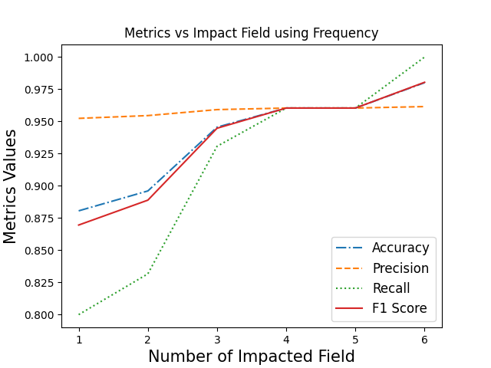
Performance Evaluation
Performance metrics using Frequency
# of Impacted field (i.e., attack severity)
Performance
Notes:
From the graph of Frequency based detection, we can see that as the number of impacted field increases, our detection mechanism shows better performance.

Slide 39
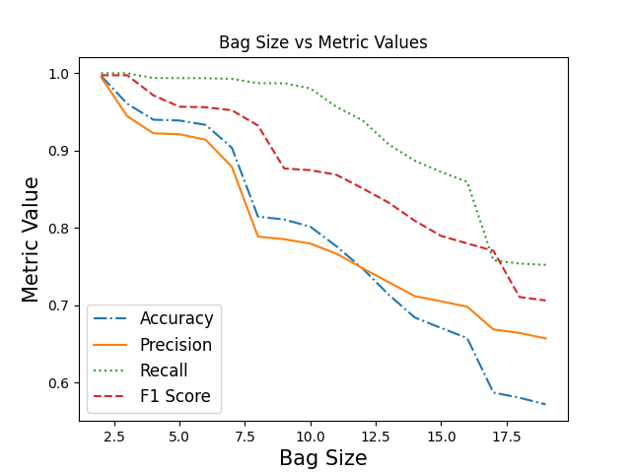
Performance Evaluation
Performance metrics using Sequence
Performance metrics show decent scores for a bag size of 2 to 6
Notes:
From the graph of sequence based detection, it is evident that bag size of 2 to 6 has the best result in our case.

Slide 40
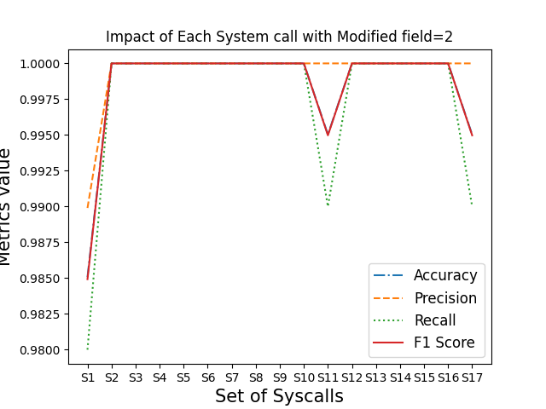
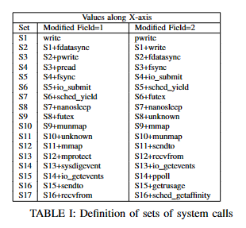
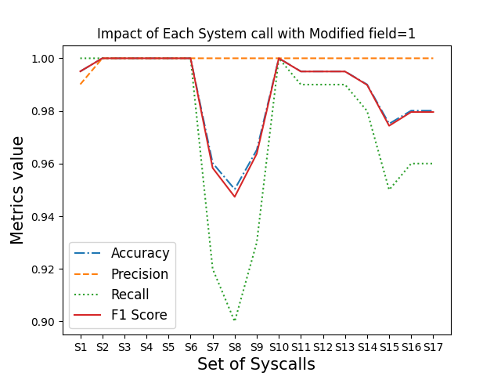
Performance Evaluation
Identifying key group of system calls
Notes:
As we have mentioned earlier, one of our key contribution is to identify key group of system calls. The X-axis of the graph on the left side represents the cumulative system calls and the Y-axis represents the performance metrics. As we can see, for 2 impacted fields, when we take into consideration nanosleep and munmap system calls performance of our detection mechanism drops by a significant amount. In this way, we identified the key group of system calls that is best suitable for our detection mechanism.

Slide 41
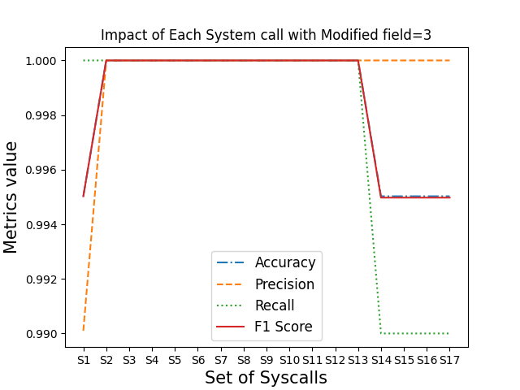
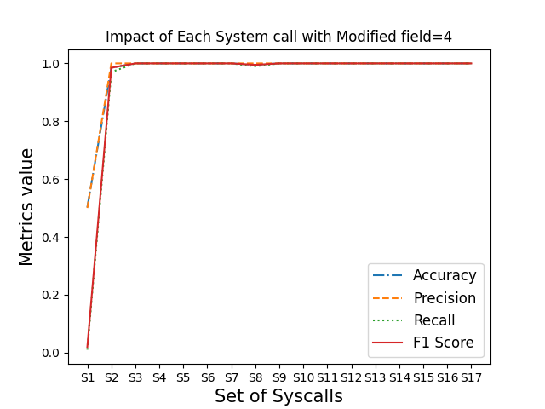
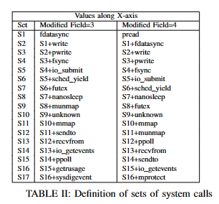
Performance Evaluation (Contd.)
Identifying key group of system calls

Slide 42
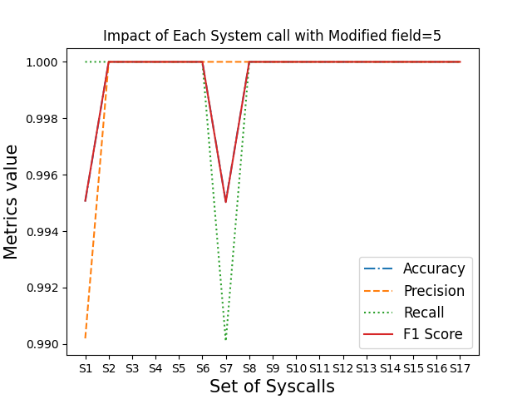
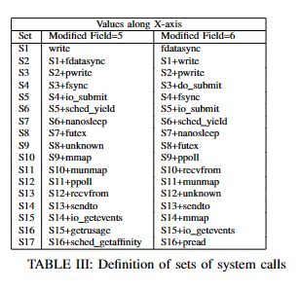
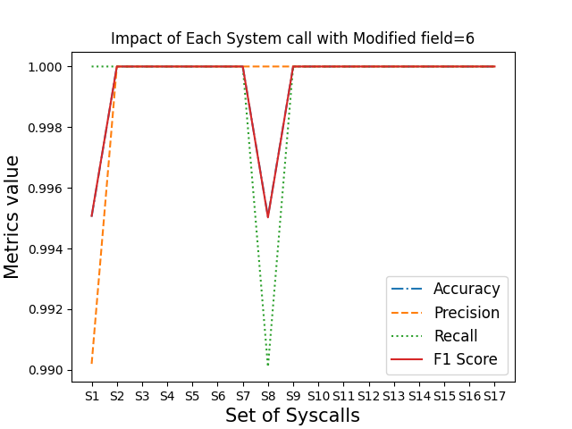
Performance Evaluation (Contd.)
Identifying key group of system calls

Slide 43
Concluding Remarks
Multi-level monitoring of container using different monitoring tools
Makes it feasible to identify an attack in a different level if an attacker manages to get past a single layer of a container without being detected
Path Specific detection mechanism
Covers lots of potential ways to inject malicious code in a container
Identifying Key group of system calls
Have increased the efficiency of our detection mechanism as we are no longer concerned about unnecessary system calls
Future research will focus on analyzing how these parameters affect learning, detection speed, and accuracy in an effort to formalize a method for maximizing their values for the intended application.
Notes:
Now lets look at the major contribution of our research work
Multi-level monitoring of container using different monitoring tools
Makes it feasible to identify an attack in a different level if an attacker manages to get past a single layer of a container without being detected
Path Specific detection mechanism
Covers lots of potential ways to inject malicious code in a container
Identifying Key group of system calls
Have increased the efficiency of our detection mechanism as we are no longer concerned about unnecessary system calls.

Slide 44
References
A. S. Abed, T. C. Clancy, and D. S. Levy, “Applying bag of system calls for anomalous behavior detection of applications in linux containers,” IEEE GC Workshops, 2015, pp. 1–5
G. R. Castanhel, T. Heinrich, F. Ceschin, and C. Maziero, “Taking a peek: An evaluation of anomaly detection using system calls for containers,” IEEE ISCC 2021, pp. 1–6
M. Cavalcanti, P. Inacio, and M. Freire, “Performance evaluation of container-level anomaly-based intrusion detection systems for multi-tenant applications using machine learning algorithms,” ARS 2021, pp. 1–9
M. Souppaya, J. Morello, and K. Scarfone, “Application container security guide,” National Institute of Standards and Technology, Tech. Rep., 2017
X. Lin, L. Lei, Y. Wang, J. Jing, K. Sun, and Q. Zhou, “A measurement study on linux container security: Attacks and countermeasures,” CSA 2018, pp. 418–429
J. Chelladhurai, P. R. Chelliah, and S. A. Kumar, “Securing docker containers from denial of service (dos) attacks,” IEEE SCC 2016, pp. 856–859
O. Tunde-Onadele, J. He, T. Dai, and X. Gu, “A study on container vulnerability exploit detection,” IEEE IC2E 2019, pp. 121– 127.
T. Bui, “Analysis of docker security,” arXiv preprint arXiv:1501.02967, 2015.
T. Yarygina and C. Otterstad, “A game of microservices: Automated intrusion response,” DAIS 2018, pp. 169–177.
V. V. Sarkale, P. Rad, and W. Lee, “Secure cloud container: Runtime behavior monitoring using most privileged container (mpc),” IEEE CSCloud 2017, pp. 351–356.
S. A. Hofmeyr, S. Forrest, and A. Somayaji, “Intrusion detection using sequences of system calls,” JCS 1998, pp. 151–180.
L. Kuang and M. Zulkernine, “An intrusion-tolerant mechanism for intrusion detection systems,” IEEE ARS 2008, pp. 319–326.
Notes:
Finally, this is the list of the related works that were quite helpful throughout our research work.

Slide 45



Thank You
Corresponding author:
Suryadipta Majumdar
suryadipta.majumdar@concordia.ca
Notes:
Thank you for your time and attention.
We appreciate the opportunity to share our research findings with you.

